Slide 1
GALACTIC ARCHAEOLOGY: The α-Elements of Destiny
By: Avidaan Srivastava
Advisors: Slava Borisov
Prof. Corinne Charbonnel
22 May 2023

Slide 2
Galactic Archaeology
Population II stars: Metal poor
Population I stars: Metal rich
Metallicity is a good tracker of Chemical Evolution in Milky Way!!
Galactic Archaeology

Slide 3
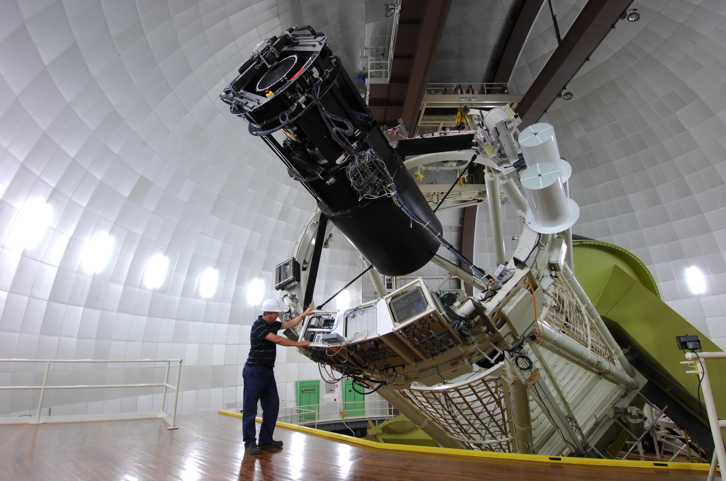
GALAH Survey
GALactic Archaeology with HERMES
HERMES spectrograph: fiber-fed, high-res, multi-object
Active since 2014
Data Release 3 (GALAH+ DR3) 588,464 stars
Supplementary info from Gaia DR3
Not all stars can be used! Data needs to be filtered
Image: AAT
Buder et al. 2021
Notes:
HERMES can simultaneously observe 400 stars

Slide 4
Data Selection
588,464 stars
NAN values:
α-Element abundance: [α/Fe], σ[α/Fe]
Metallicity: [Fe/H]
Sun-Star distance
Galactic coordinates
Age
Kinematics (Gaia)
GALAH+ DR3 and Gaia quality flags:
Gaia astrometry (ruwe < 1.4)
Stellar Parameters (flag_sp = 0)
α-Element abundance (flag_alpha_fe = 0)
Metallicity (flag_fe_h = 0)
Signal to Noise (SNR > 30)
358,216 stars
259,222 stars
235,725 stars
235,725 stars
235,665 stars
208,920 stars
Notes:
E_alpha_fe ranges b/w 0.3 and 0.01 so we picked 0.05 as a good base (mean error is 0.05)

Slide 5
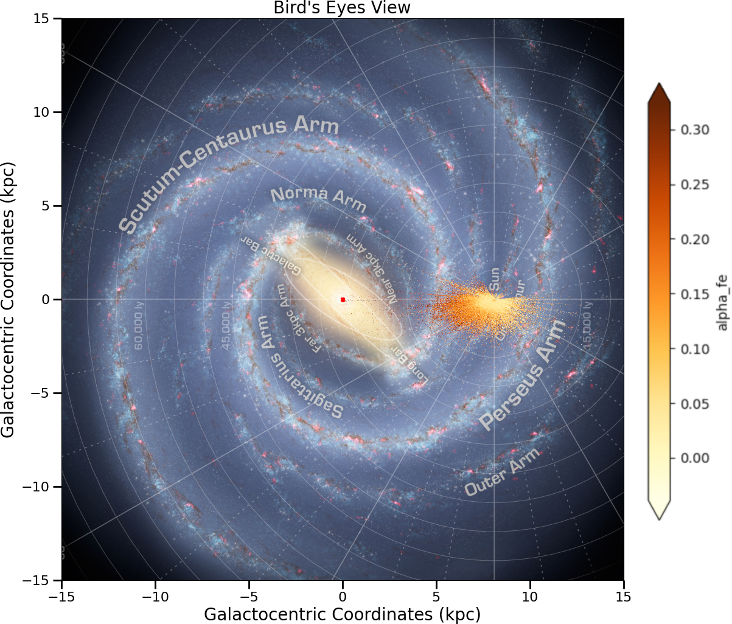
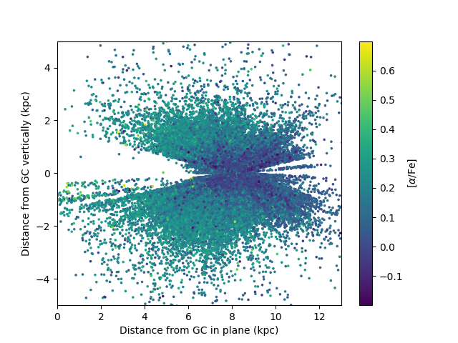
Distribution of Stars
61% stars within 1kpc of Sun
26% stars within 500pc of Sun

Slide 6
Tinsley-Wallerstein diagram
Thin Disk: Pop I Young stars Low [α/Fe]
Thick Disk: Pop II Old stars High [α/Fe]
(Buder et al. 2021)
Way to chemically distinguish Thin and Thick disk stars of Milky Way
Uses: [Fe/H] and [α/Fe]
α-elements: C, O, Ne, Mg, Si, S, Ar, Ca, Ti
Notes:
Alpha elements produced on short timescales primarily through type 2b SNe

Slide 7
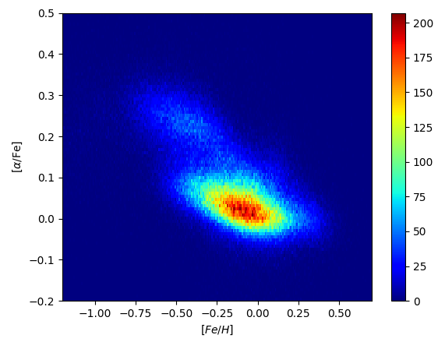
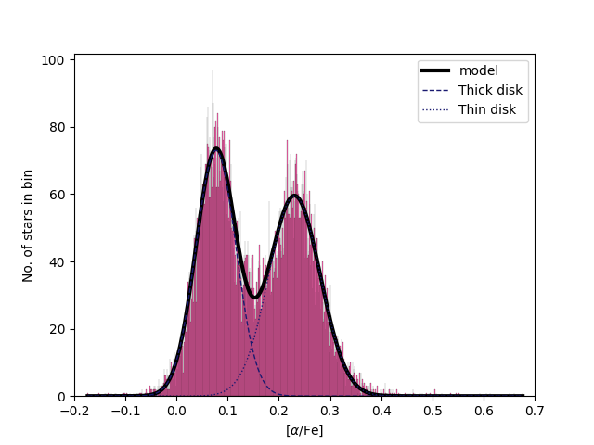
Tinsley-Wallerstein diagram
Thick
Point of Intersection
Thin
Notes:
Bins: -0.8, -0.4; -0.4, -0.2, -0.2, 0, 0, 0.2

Slide 8
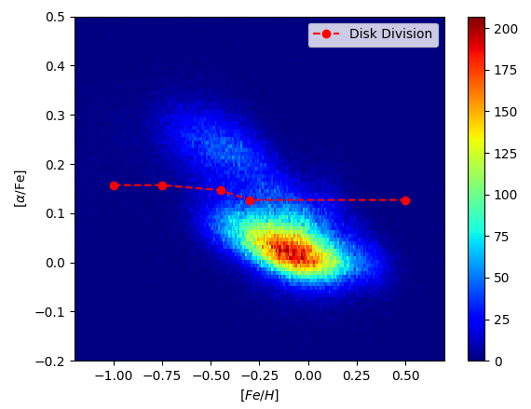
Tinsley-Wallerstein diagram
Thick
Thin

Slide 9
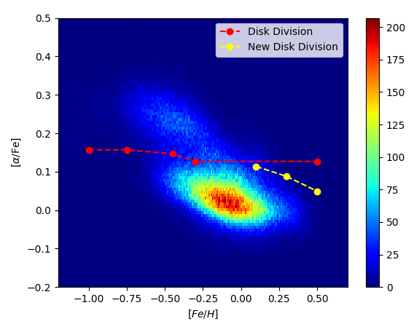
Tinsley-Wallerstein diagram
Thick
Thin

Slide 10
Toomre Diagram
Distinguish Thin and Thick disk stars Kinematically
Thin Disk lower KE
Thick Disk higher KE
(Beers et al. 2014)

Slide 11
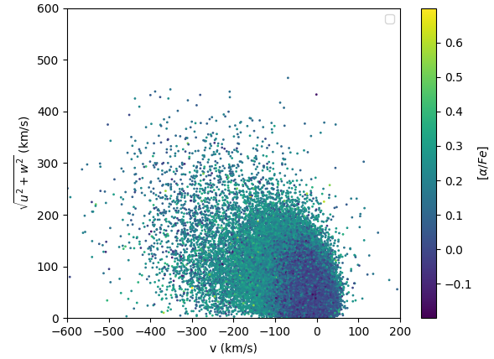
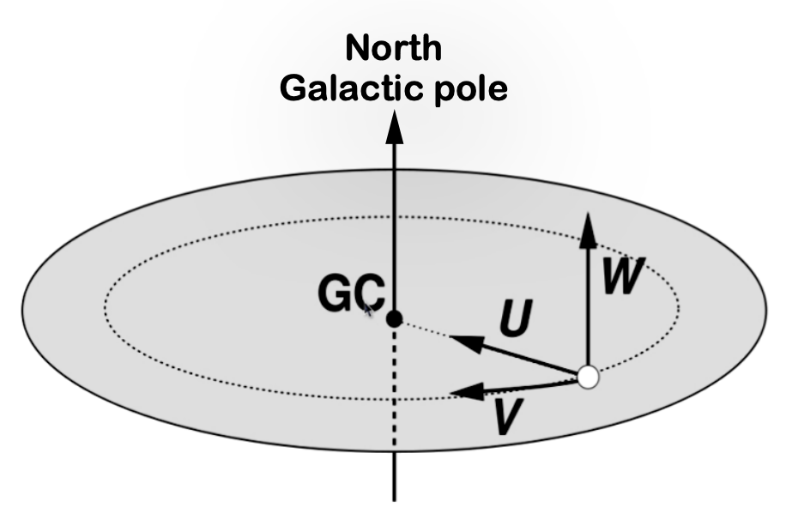
Toomre Diagram

Slide 12
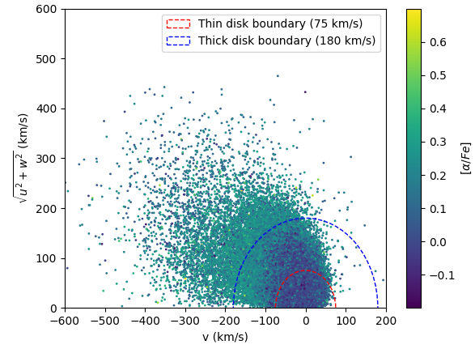
Toomre Diagram
Bensby et al. 2011
Notes:
Low alpha elements have high orbital energies (https://iopscience.iop.org/article/10.1088/0004-637X/753/1/64)
Low alpha elements show signs that they have been accreted (same paper)

Slide 13
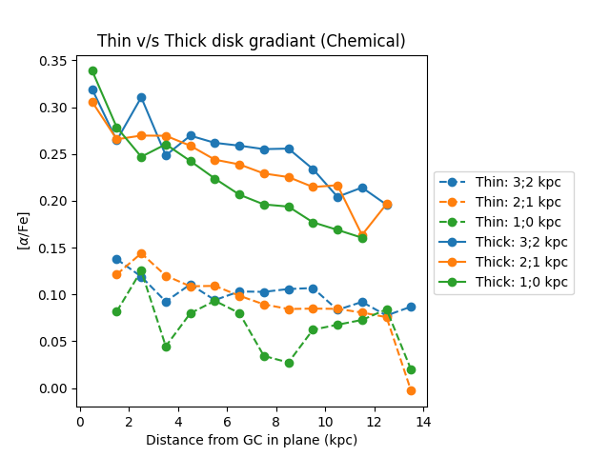
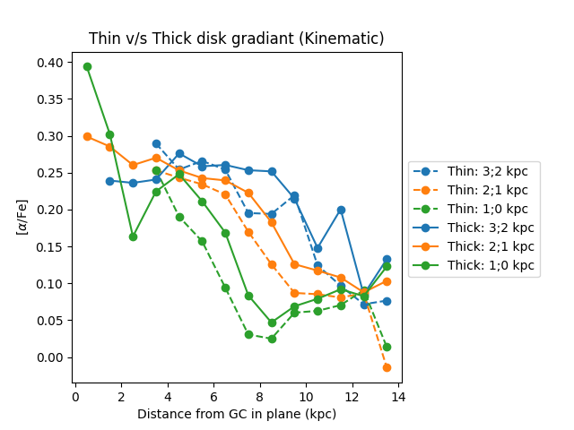
α-Element Gradient
Thick Disk
Thin Disk

Slide 14
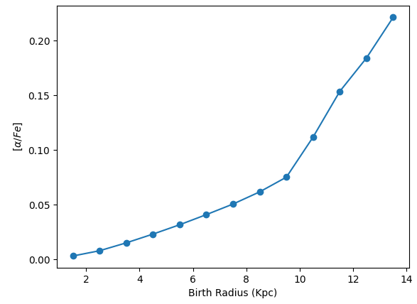
Birth Radius
RBirth = ( [Fe/H]star – [Fe/H]ISM ) / grad[Fe/H] + Rsun (Minchev et al. 2018)
Gives estimate of how MW stars have migrated

Slide 15

Conclusions
High [α/Fe] stars towards Galactic Center
Chemical and Kinematic methods agree (to some capacity!!)
Birth Radius trend suggests: Old stars migrated inwards
Questions?
Image: Indiana Jones and the Temple of Doom
Notes:
Stellar abundances in star’s atmospheres are conserved and can be use to trace their origin (GAIA paper 2022)

Slide 16
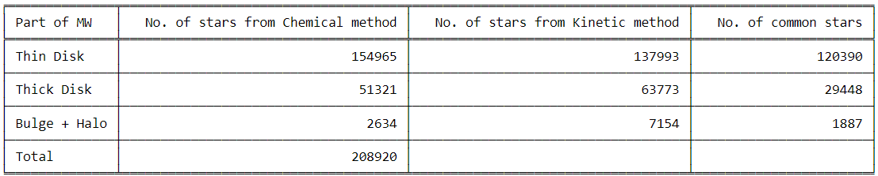
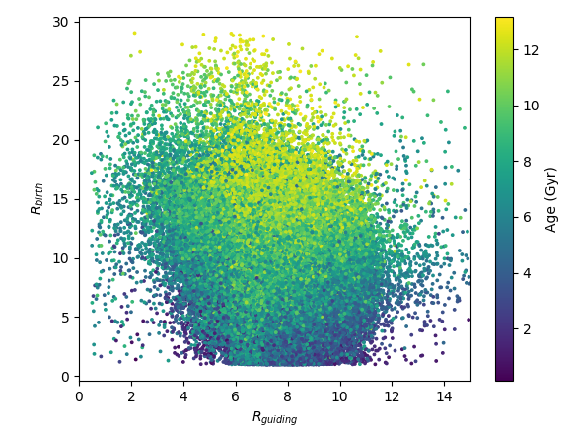
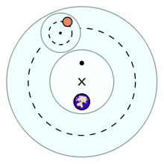
Image: Wikipedia

Slide 17
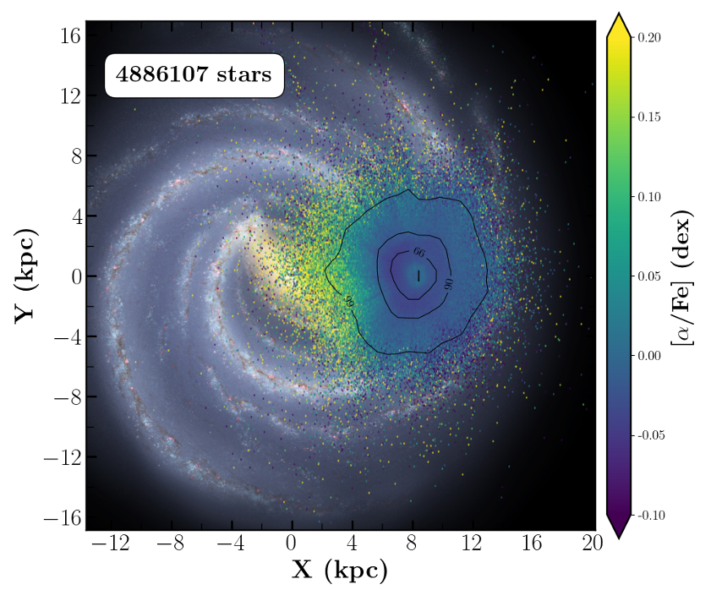
Gaia Data Release 3: Chemical cartography of the Milky Way (2022)

